Slide 1
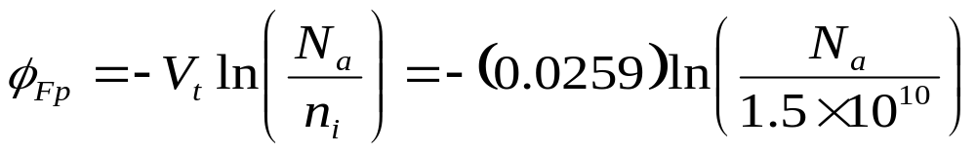
EXAMPLE 6.1
OBJECTIVE
Determine the potential φ_{Fp} in silicon at T = 300 K for (a) N_{a} = 10¹⁵ cm⁻³ and (b) N_{a} = 10¹⁷ cm⁻³.
Solution
From Equation (6.8b), we have
so for (a) N_{a} = 10¹⁵ cm⁻³,
φ_{Fp} = −0.288 V
and for (b) N_{a} = 10¹⁷ cm⁻³,
φ_{Fp} = −0.288 V
Comment
This simple example is intended to show the order of magnitude of φ_{Fp} and to show, because of the logarithm function, that φ_{Fp} is not strong function of substrate doping concentration.

Slide 2
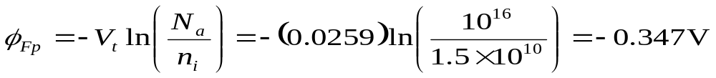
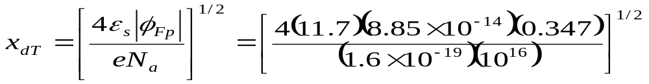
EXAMPLE 6.2
OBJECTIVE
Calculate the maximum space charge width given a particular semiconductor doping concentration.
Consider silicon at T = 300 K doped to N_{a} = 10¹⁶ cm⁻³.
Solution
From Equation (6.8b), we have
Then the maximum space charge width is
or
x_{dT} = 0.30 × 10⁻⁴ = 0.30 μm
Comment
The maximum induced space charge width is on the same order of magnitude as pn junction space charge widths.

Slide 3
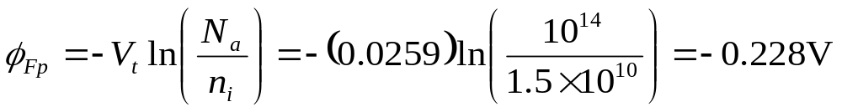
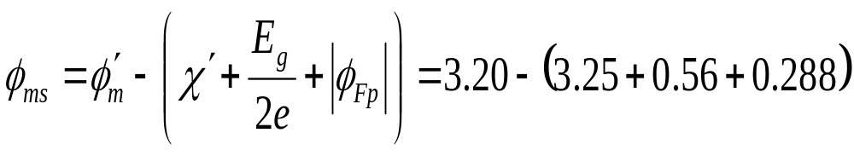
EXAMPLE 6.3
OBJECTIVE
Calculate the metal-semiconductor work function difference φ_{ms} for a given MOS system and semiconductor doping.
For an aluminum-silicon dioxide junction, φ′_{m} = 3.20 V and for a silicon-silicon dioxide junction, χ′ = 3.25 V. We can assume that E_{g} = 1.12 eV. Let the p-type doping be N_{a} = 10¹⁴ cm⁻³.
Solution
For silicon at T = 300 K, we can calculate φ_{Fp} as
Then the work function difference is
or
φ_{ms} = -0.838 V
Comment
The value of φ_{ms} will become more negative as the doping of the p-type substrate increases.

Slide 4
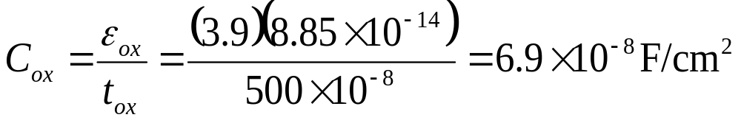
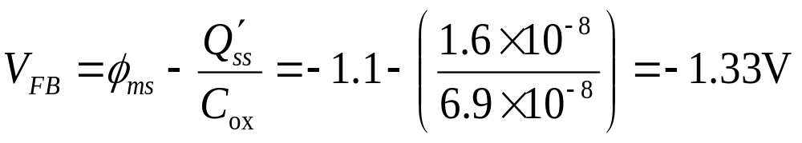
EXAMPLE 6.4
OBJECTIVE
Calculate the flat-band voltage for a MOS capacitor with a p-type semiconductor substrate.
Consider an MOS structure with a p-type semiconductor substrate doped to N_{a} = 10¹⁶ cm⁻³, a silicon dioxide insulator with a thickness of t_{ox} = 500 Ǻ, and an n⁺ polysilicon gate. Assume that Q′_{ss} =10¹¹ electronic charges per cm².
Solution
The work function difference, from Figure 6.21, is φ_{ms} = − 1.1 V. The oxide capacitance can be found as
The equivalent oxide surface charge density is
Q′_{ss} = (10¹¹)(1.6 × 10⁻¹⁹)= 1.6 × 10⁻⁸ C/cm²
The flat-band voltage is then calculated as
Comment
The applied gate voltage required to achieve the flat-band condition for this p-type substrate is negative. If the amount of fixed oxide charge increases, the flat-band voltage becomes even more negative.

Slide 5
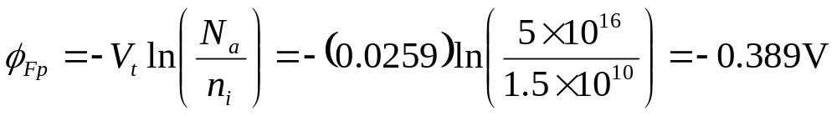
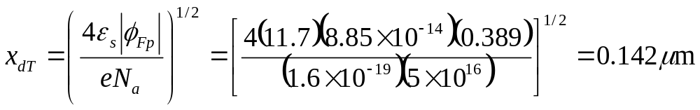
EXAMPLE 6.5
OBJECTIVE
Design the oxide thickness of an MOS system to yield a specified threshold voltage.
Consider an n⁺ polysilicon gate and a p-type silicon substrate doped to N_{a} = 5 × 10¹⁶ cm⁻³. Assume Q′_{ss} = 10¹¹ cm⁻². Determine the oxide thickness such that V_{TN} = + 0.40 V.
Solution
From Figure 6.21, the work function difference is φ_{ms} ≈ −1.15 V. The other various parameters can be calculated as
and
Then
|Q′_{SD}(max)| = eN_{a}x_{dT} = (1.6 × 10⁻¹⁹)(5 × 10¹⁶)(0.142 × 10⁻⁴)
or
|Q′_{SD}(max)| = 1.14 × 10⁻¹⁷ C/cm²

Slide 6
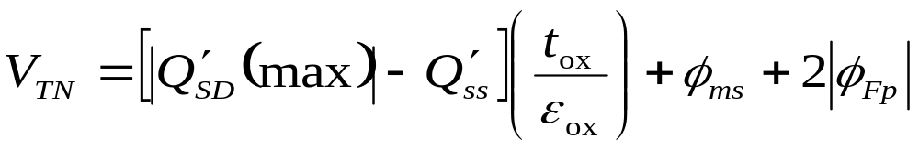
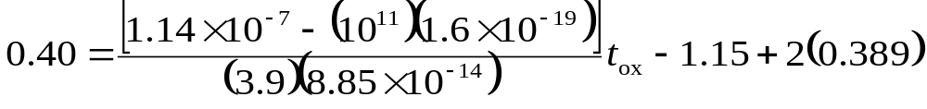
EXAMPLE 6.5
Solution
The oxide thickness can be determined from the threshold equation
Then
which yields
t_{ox} = 272 Ǻ
Comment
The threshold voltage for this case is a positive quantity, which means that the MOS device is an enhancement-mode device; a gate voltage must be applied to create the inversion layer charge, which is zero for zero applied gate voltage.

Slide 7

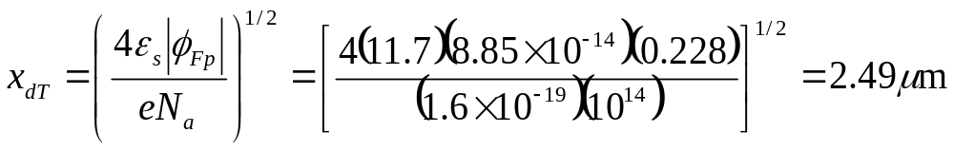
EXAMPLE 6.6
OBJECTIVE
Calculate the threshold voltage of an MOS system using an aluminum gate.
Consider a p-type silicon substrate at T = 300 K doped to N_{a} = 10¹⁴ cm⁻³. Let Q′_{ss} = 10¹⁰ cm⁻², t_{ox} = 500 Ǻ, and assume the oxide is silicon dioxide. From Figure 6.21, we have that φ_{ms} = −0.83 V.
Solution
We can start calculating the various parameters as
and
Then
|Q′_{SD}(max)| = eN_{a}x_{d}T = (1.6 × 10⁻¹⁹)(10¹⁴)(2.43 × 10-⁴) = 3.89 × 10⁻⁹ = 3.89 × 10⁻⁹ C/cm²

Slide 8
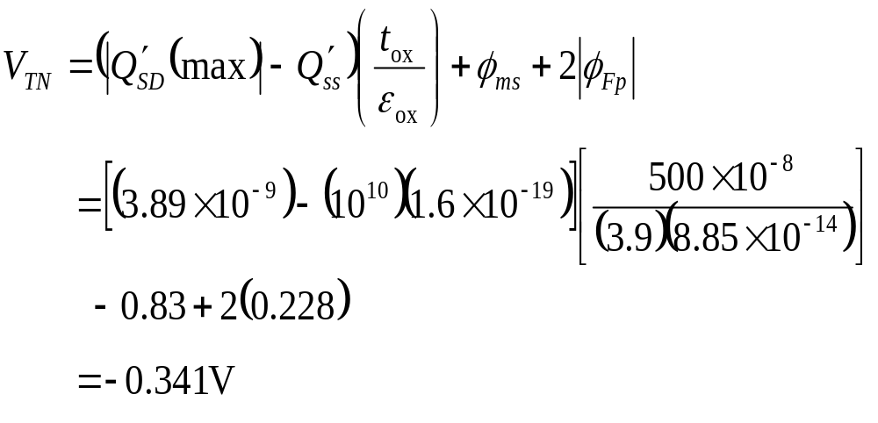
EXAMPLE 6.6
Solution
We can now calculate the threshold voltage as
Comment
In this example, the semiconductor is very lightly doped, which, in conjunction with the positive charge in the oxide and the work function potential difference, is sufficient to induce an electron inversion layer charge even with zero applied gate voltage. This condition makes the threshold voltage negative.

Slide 9
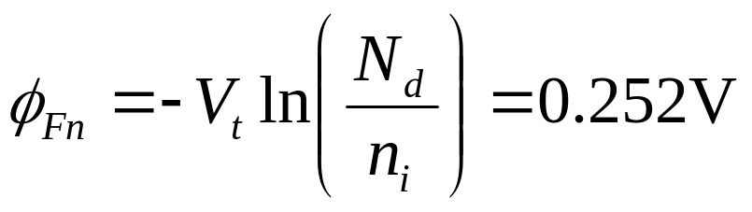
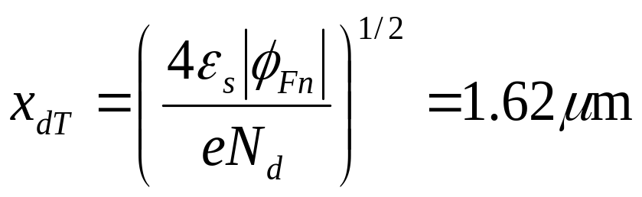
EXAMPLE 6.7
OBJECTIVE
Design the semiconductor doping concentration to yield a specified threshold voltage.
Consider an aluminum-silicon dioxide-silicon MOS structure. The silicon is n type, the oxide thickness is t_{ox} = 500 Ǻ, and the trapped charge density is Q′_{ss} = 10¹⁰ cm⁻². Determine the doping concentration such that V_{TP} = −1.0 V.
Solution
The solution to this design problem is not straightforward, since the doping concentration appears in the terms φ_{Fn} , x_{dT} , Q′_{SD}(max), and φ_{ms} . The threshold voltage, then, is a nonlinear function of N_{d} . Without a computer-generated solution, we resort to trial and error.
For N_{d} = 2.5 × 10¹⁴ cm⁻³, we find
and
Then
|Q′_{SD}(max)| = eN_{a}x_{d}T = 6.48 × 10⁻⁹ C/cm²

Slide 10
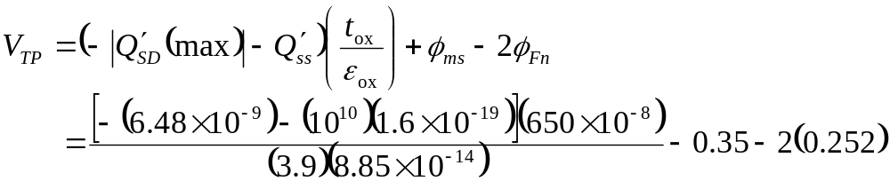
EXAMPLE 6.7
Solution
From Figure 6.21,
φ_{ms} = −0.35 V
the threshold voltage is
which yields
V_{TP} = -1.006 V
and is essentially equal to the desired result.
Comment
The threshold voltage is negative, implying that this MOS capacitor, with the n-type substrate, is an enhancement mode device. The inversion layer charge is zero with zero gate voltage, and a negative gate voltage must be applied to induce the hole inversion layer.

Slide 11
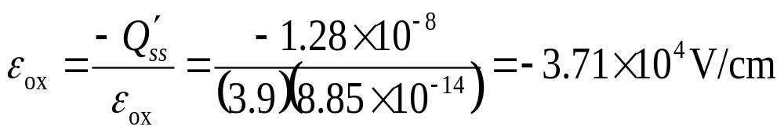
EXAMPLE 6.8
OBJECTIVE
Calculate the electric field in and the voltage across the oxide at a flat-band condition.
Assume that Q′_{ss} = 8 × 10¹⁰ cm⁻² in silicon dioxide and assume the oxide thickness is t_{ox} = 500 Ǻ.
Solution
The electric charge density at the interface is
Q′_{ss} = (1.6 × 10⁻¹⁹)(8 × 10¹⁰) = 1.28 × 10⁻⁸ C/cm²
The oxide electric field is then
Since the electric field across the oxide is a constant, the voltage across the oxide is then
V_{ox} = −ε_{ox}t_{ox} = −(−3.71 × 10⁴) (150 × 10⁻⁸
or
V_{ox} = 55.6 mV
Comment
In the flat-band condition, an electric field exists in the oxide and a voltage exists across the oxide due to the Q′_{ss} charge.

Slide 12
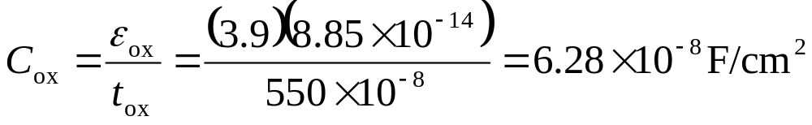

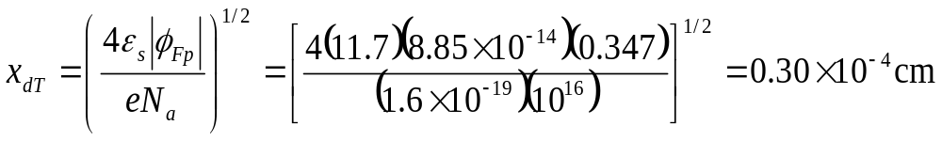
EXAMPLE 6.9
OBJECTIVE
Calculate C_{ox} , C′_{min} , and C′_{FB} for an MOS capacitor.
Consider a p-type silicon substrate at T = 300 K doped to N_{a} = 10¹⁶ cm⁻³. The oxide is silicon dioxide with a thickness of 500 Ǻ and the gate is aluminum.
Solution
The oxide capacitance is
To find the minimum capacitance, we need to calculate
and

Slide 13
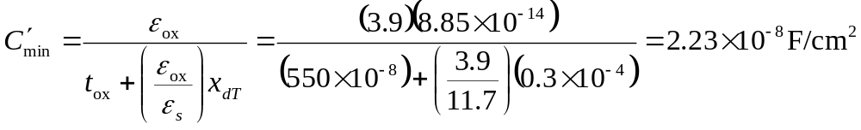
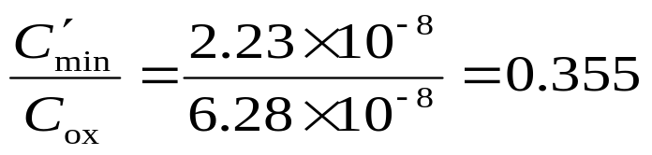
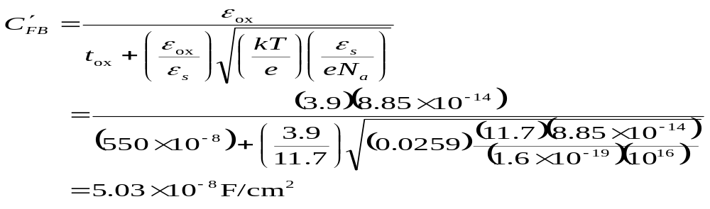
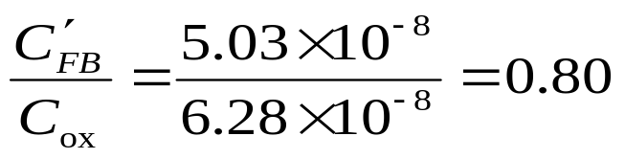
EXAMPLE 6.9
Solution
Then
We can note that
The flat-band capacitance is
We can also note that
Comment
The ratios of C′_{min} to C_{ox} and of C′_{FB} to C_{ox} are typical values obtained in C – V plots.

Slide 14
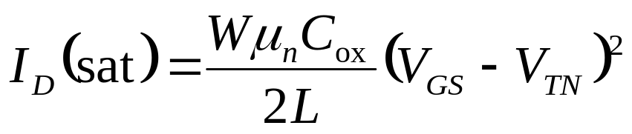
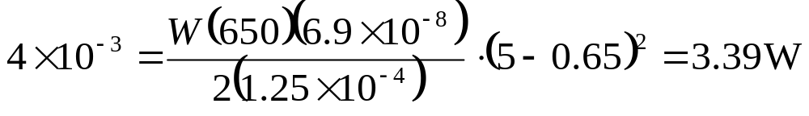
EXAMPLE 6.10
OBJECTIVE
Design the width of a MOSFET such that a specified current is induced for a given applied bias.
Consider an ideal n-channel MOSFET with parameters L = 1.25 μm, μ_{n} = 650 cm²/V-s, C_{ox} = 6.9 × 10⁻⁸ F/cm², and V_{T} = 0.65 V. Design the channel width W such that I_{D}(sat) = 4 mA for V_{GS} = 5 V.
Solution
We have, from Equations (6.51) and (6.52),
or
Then
W = 11.8 μm
Comment
The current capability of a MOSFET is directly proportional to the channel width W. The current handling capability can be increased by increasing W.

Slide 15
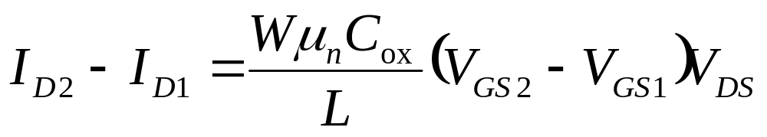
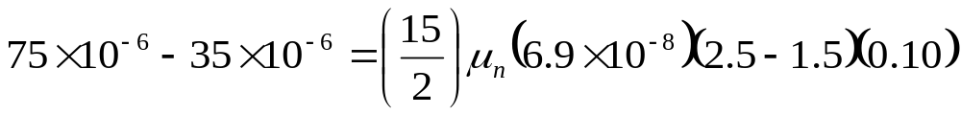
EXAMPLE 6.11
OBJECTIVE
Determine the inversion carrier mobility from experimental results.
Consider an n-channel MOSFET with W = 15 μm, L = 2 μm, and C_{ox} = 6.9 × 10⁻⁸ F/cm². Assume that the drain current in the nonsaturation region for V_{DS} = 0.10 V is I_{D} = 35 μA at V_{GS} = 1.5 V and I_{D} = 75 μA at V_{GS} = 2.5 V.
Solution
From Equation (6.58), we can write
so that
which yields
μ_{n} = 773 cm²/V-s
Comment
The mobility of carriers in the inversion layer is less than that in the bulk semiconductor due to the surface scattering effect. We will discuss this effect in the next chapter.

Slide 16
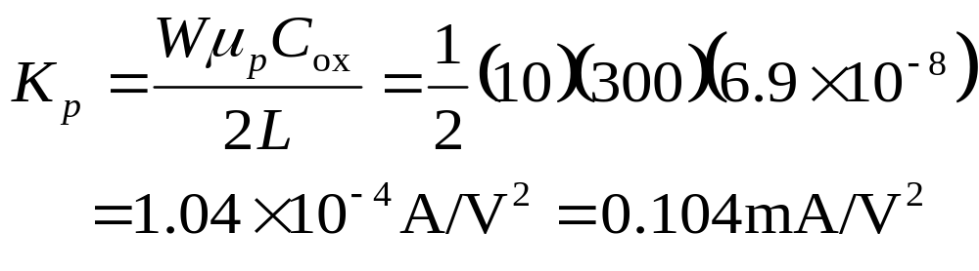
EXAMPLE 6.12
OBJECTIVE
Determine the conduction parameter and current in a p-channel MOSFET.
Consider a p-channel MOSFET with parameters μ_{p} = 300 cm²/V-s, C_{ox} = 6.9 × 10⁻⁸ F/cm², (W/L) = 10, and V_{TP} = -0.65 V. Determine the conduction parameter K_{p} and find the maximum current at V_{SG} = 3 V.
Solution
We have
The maximum current occurs when the transistor is biased in the saturation region, or
I_{D} = K_{p}(V_{SG} + V_{TP})² = 0.104[3 + (-0.65)]² = 0.574 mA
Comment
The conduction parameter, for a given width-to-length ratio, of a p-channel MOSFET is approximately one-half that of an n-channel MOSFET because of the reduced hole mobility value.

Slide 17
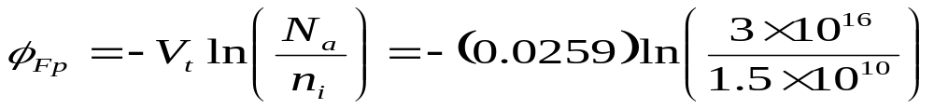
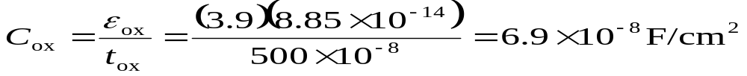
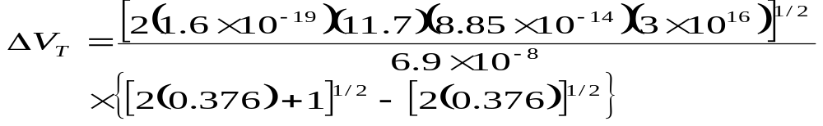

EXAMPLE 6.13
OBJECTIVE
Calculate the change in the threshold voltage due to an applied source-to-body voltage.
Consider an n-channel silicon MOSFET at T = 300 K. Assume the substrate is doped to N_{a} = 3 × 10¹⁶ cm⁻³ and assume the oxide is silicon dioxide with a thickness of t_{ox} = 500 Ǻ. Let V_{SB} = 1 V.
Solution
We can calculate that
We can also find
Then from Equation (6.87), we can obtain
or
ΔV_{T} = 1.445(1.324-0.867) = 0.66 V
Comment
Figure 6.64 shows plots of versus V_{GS} for various values of applied V_{SB}. The original threshold voltage, V_{T0} , is 0.64 V.

Slide 18
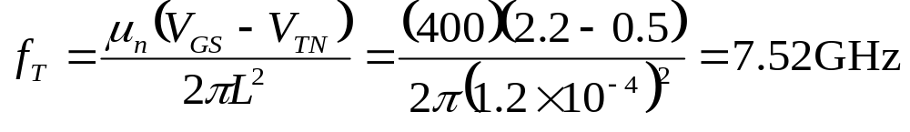
EXAMPLE 6.14
OBJECTIVE
Calculate the cutoff frequency of an ideal MOSFET with a constant mobility.
Assume that the electron mobility in an n-channel device is μ_{n} = 400 cm²/V-s and that the channel length is L = 1.2μm. Also assume that V_{TN} = 0.5 V and let V_{GS} = 2.2 V.
Solution
From Equation (6.103), the cutoff frequency is
Comment
In an actual MOSFET, the effect of parasitic capacitance will substantially reduce the cutoff frequency from that calculated in this example.

